Slide 1
Burlington – Lamar 230kV Transmission Line Project
Prowers County Public Hearing
August 2022

Slide 2
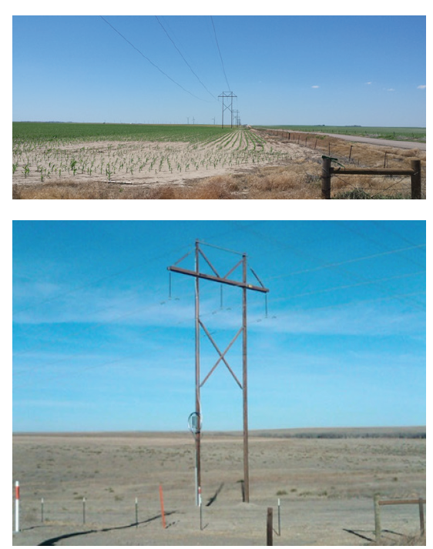
Introductions
Selina Koler, Tri-State
  Senior Transmission Siting and Environmental Planner
Denise Gibbons, Tri-State
  Land Rights Agent
Paul Scrivens, Tri-State
  Project Manager
Charlie Fung, Tri-State
  Transmission Engineer
Steve Gray, Tri-State
  Senior Manager, Lands and Permitting

Slide 3
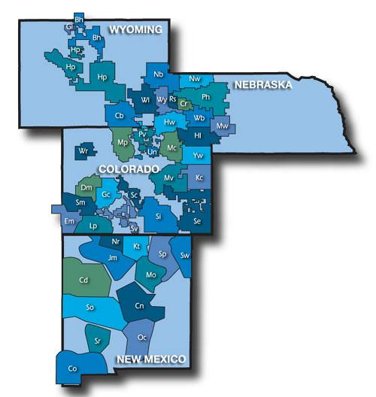
Who is Tri-State
Founded in 1952
Not-for-profit wholesale electric power provider
Serves over 42 Member Cooperatives
  Southeast Colorado Power Association
  K.C. Electric Association
200,000 square-mile service area
1.5 million customers

Slide 4
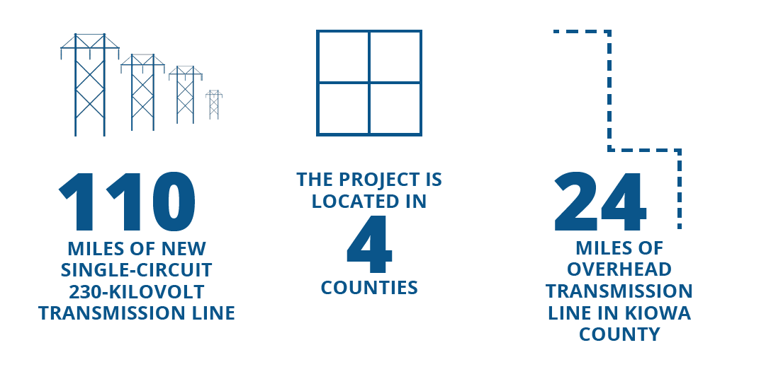
Project Introduction
Tri-State is proposing to construct approximately 110 miles of new single-circuit 230-kilovolt transmission line connecting the existing Burlington and Lamar substations.
The transmission line will be located in Kit Carson, Cheyenne, Kiowa and Prowers counties.
Received CPCN in 2015
22
MILES OF OVERHEAD TRANSMISSION IN PROWERS COUNTY

Slide 5
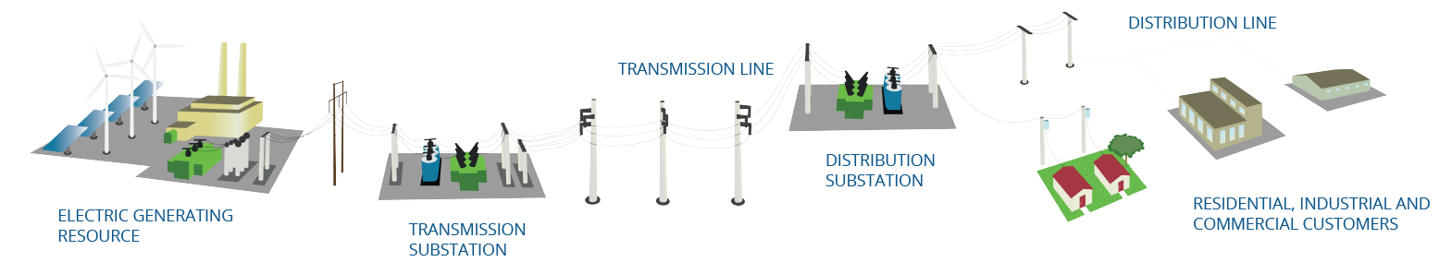
Purpose and Need
  System Reliability
  Reliable electric service delivery to our Members.
  Increased operational flexibility for maintenance outages.
  Better system performance.
  Efficiencies during emergencies.
  Transmission Constraints
  Help incrementally alleviate existing and future transmission system constraints in southeast and eastern Colorado.
  Facilitate the delivery of electricity to the areas of highest demand.
  Provide increased opportunities for renewable resource interconnections.
  Renewable Potential
  Expanding renewable energy generation, reducing emissions and ensuring affordable and responsible electricity for our Members.
  Supporting over 1,000 megawatt of new utility-scale wind and solar project development
  Helping achieve our goal of 100% clean energy in Colorado by 2040.

Slide 6
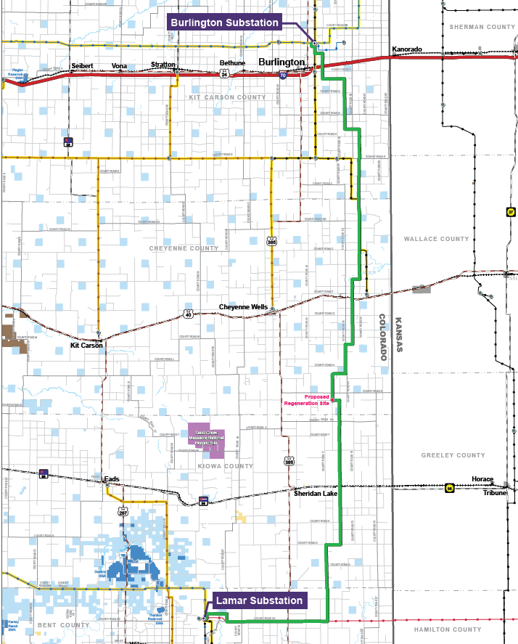
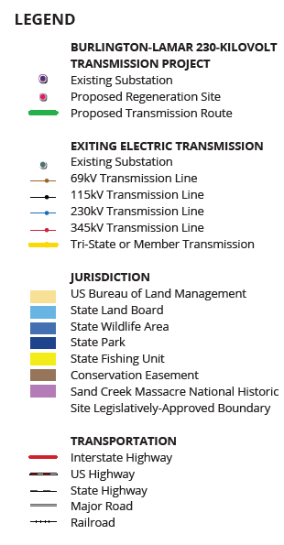
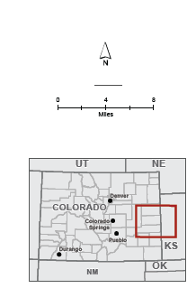
Location

Slide 7
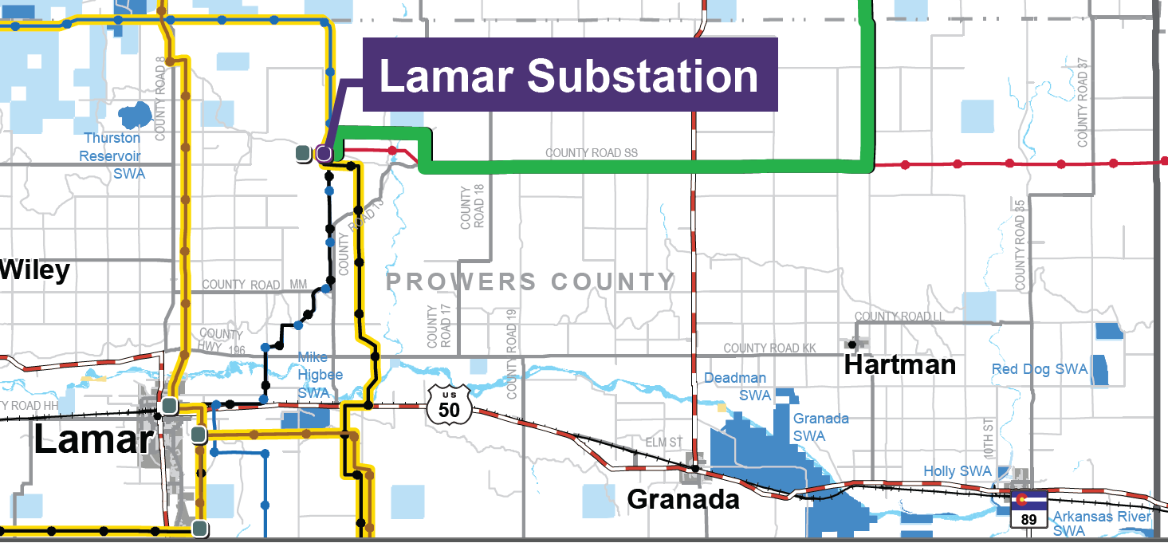
Location – Prowers County

Slide 8
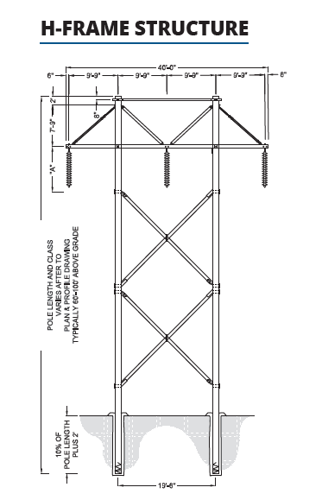
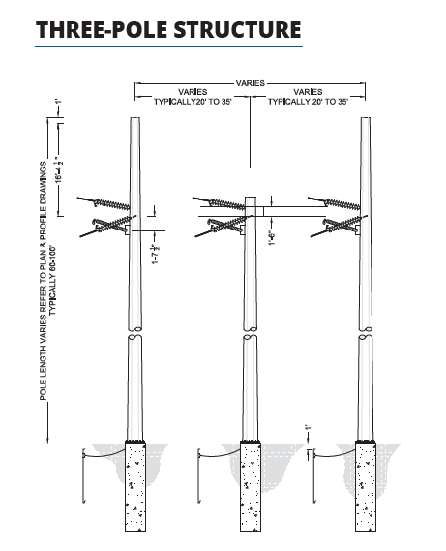
Project Description
New 230-kV transmission line
  Private and State land
  150 - 200’ ROW
  Combination of wood and steel structures
    6 – 9 structures per mile
    52’-103’ above ground
    650-1300’ between structures
    28’ minimum ground clearance
  Optical ground wire
      Internal communications
  Telecom Fiber Regen Site
    Cheyenne County
Improvements to Burlington and Lamar Substations
  Within existing yards

Slide 9
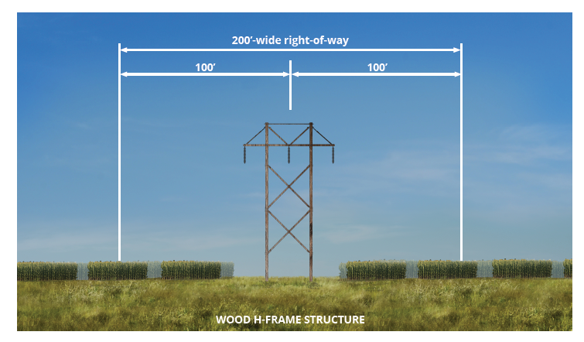
Working with Landowners
Tri-State is working directly with affected landowners to acquire the necessary transmission line easements for projects.
Temporary access or survey permission to perform survey activities and geotechnical investigations.
Engineering, environmental and land surveying studies are conducted to complete a detailed assessment of a line’s alignment.
Easements for construction and long-term maintenance of transmission lines.
Tri-State’s objective is to work closely with the landowners to negotiate easement terms. When negotiations are unsuccessful, as an electric utility, Tri-State may have to exercise its eminent domain authority. Fortunately, these are rare cases.

Slide 10



Easements and Agriculture
Center Pivots: Tri-State will avoid irrigation equipment to the extent possible. Each individual situation will be worked out with the landowner.
Planting and Harvesting: Tri-State will work with individual landowners to avoid construction during the planting and harvesting seasons. If damage to crops cannot be avoided, compensation for crop loss will be offered.
Livestock: Segments of fences may be removed during line construction, but Tri-State will work with landowners to minimize impacts to livestock

Slide 11
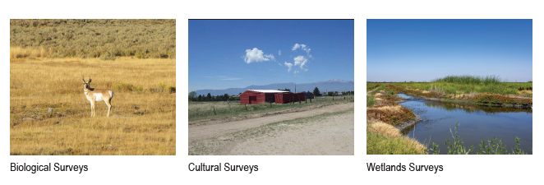
Permitting
Other permits
    County 1041 and Land Use Permits
    Colorado Department of Transportation
      Crossing Permits
    Colorado Parks and Wildlife (CPW)
      Surveys, Consultation
    Federal Endangered Species Act
      Likely listing of LPC in July – not in Kit Carson County
    US Army Corps of Engineers
      Section 404, Nationwide Permit
    Colorado Department of Public Health and Environment
      Construction Stormwater Permit
Biological
Cultural
Wetlands

Slide 12
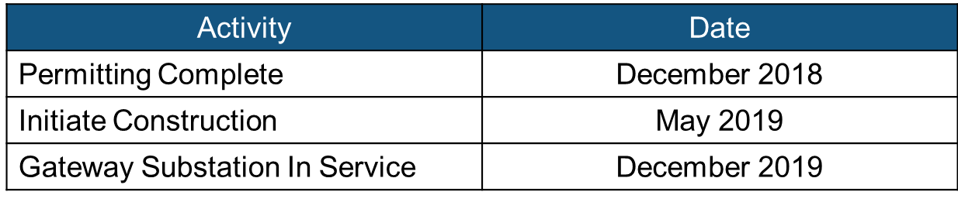
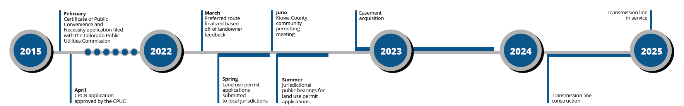
Schedule
Permitting and Easement Acquisition
2022 through 2024
Initiate Construction
First Quarter 2024
Project In Service
First Quarter 2025

Slide 13
Questions?

Slide 15
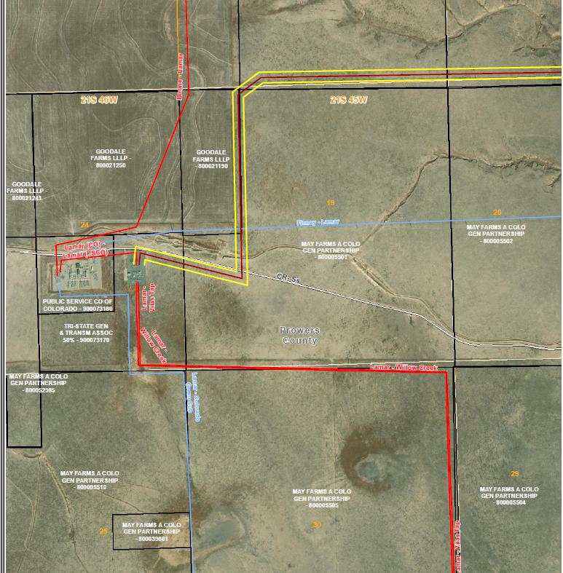

Slide 16
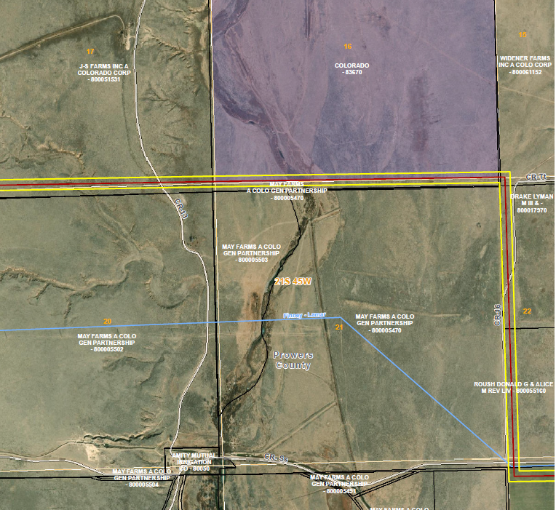

Slide 17
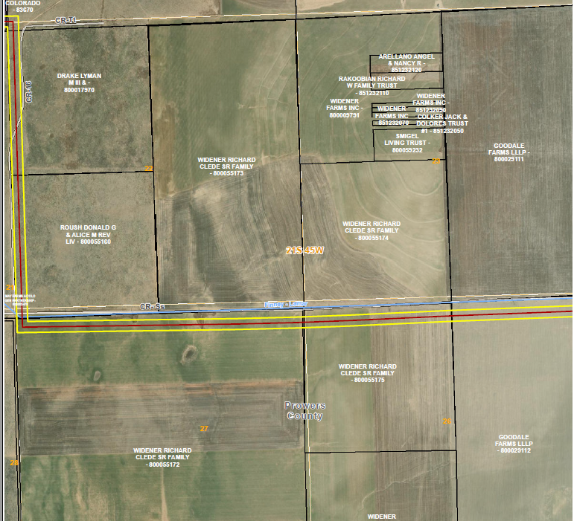

Slide 18
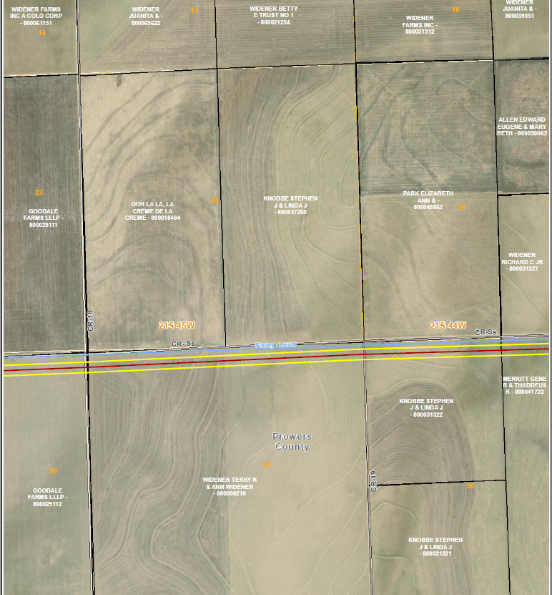

Slide 19
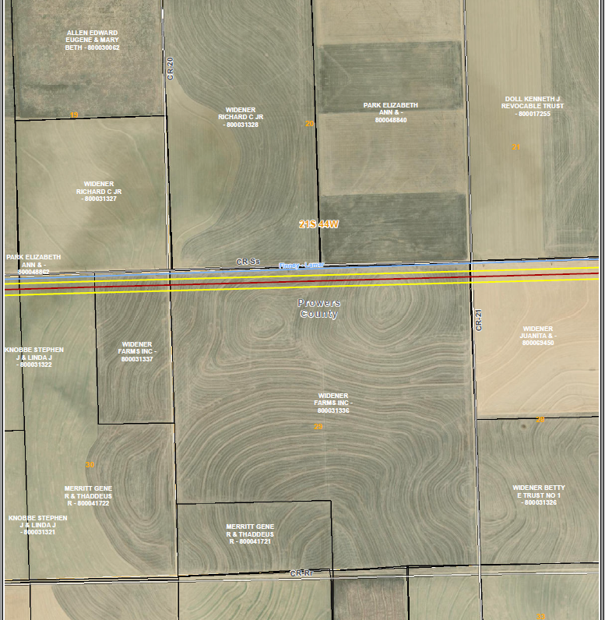

Slide 20
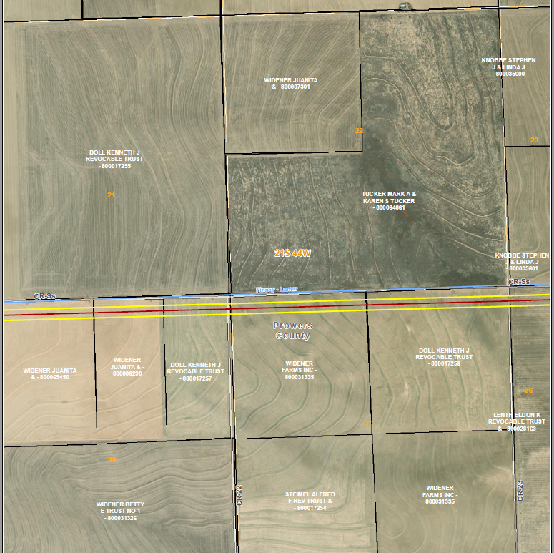

Slide 21
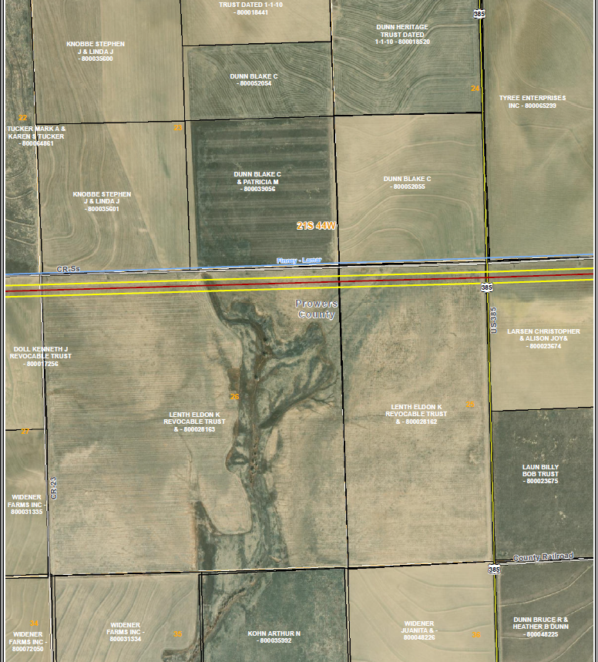

Slide 22
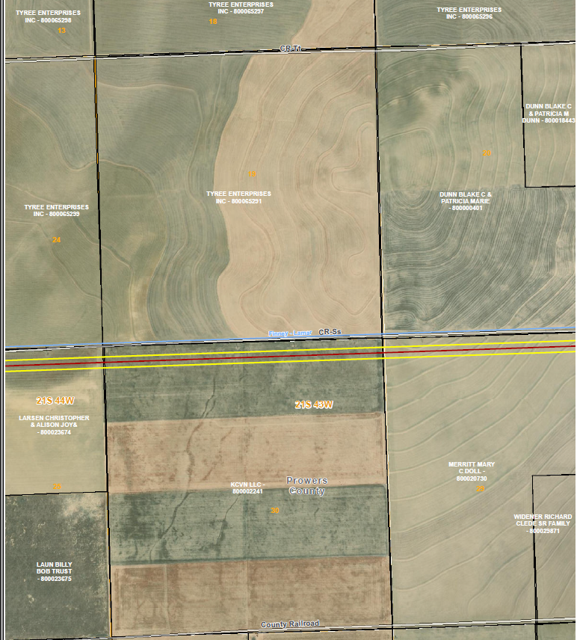

Slide 23
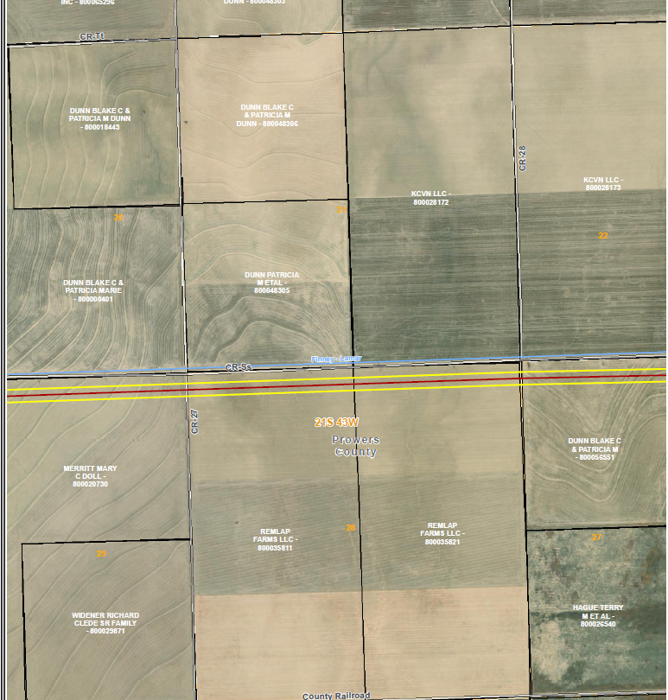

Slide 24
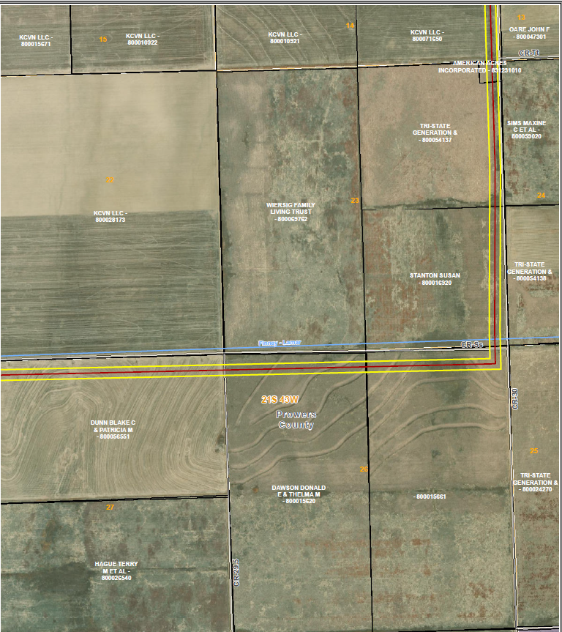

Slide 25
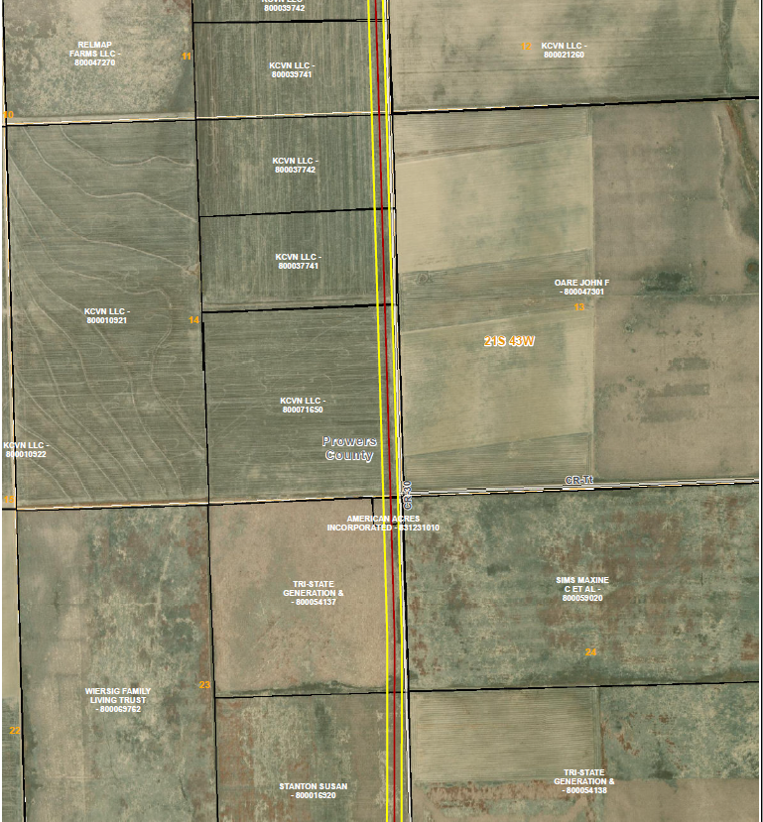

Slide 26
